Slide 1






Welcome 1
QCRYPT
Fast coherent-one way quantum key distribution and high-speed encryption
Nino Walenta
University of Geneva, GAP-Optique
Zurich, 13.09.2011
“A next generation 0.1-Terabit encryption device that can be seamlessly embedded in network infrastructures to provide quantum enabled security.”

Slide 2
Outline 2
QCRYPT
Fast coherent-one way quantum key distribution and high-speed encryption
Introduction
The QKD engine
The hardware key distillation engine
The 100 Gbit/s encryption engine
Outlook

Slide 3
Interdisciplinary competences 3
Nino Walenta, Charles Lim Ci Wen, Raphael Houlmann, Olivier Guinnard, Hugo Zbinden, Rob Thew, Nicolas Gisin
Etienne Messerli, Pascal Junod, Gregory Trolliet, Fabien Vannel, Olivier Auberson, Yann Thoma
Norbert Felber, Christoph Keller, Christoph Roth, Andy Burg
Patrick Trinkler, Laurent Monat, Samuel Robyr, Lucas Beguin, Matthieu Legré, Grégoire Ribordy

Slide 4
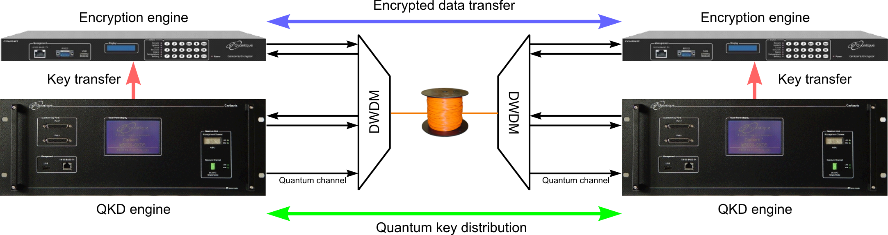
QCrypt Specifications 4
625 Mbit/s clocked QKD
1.25 GHz Rapid gated single photon detectors
Hardware key distillation
1 Mbit/s One-Time-Pad encryption
1-fibre DWDM configuration
Continuous and reliable operation
10 Ethernet channels at 10 Gbit/s
100 Gbit/s AES encryption engine
100 Gbit/s data channel over a single fiber
Tamper proof
Certification

Slide 5
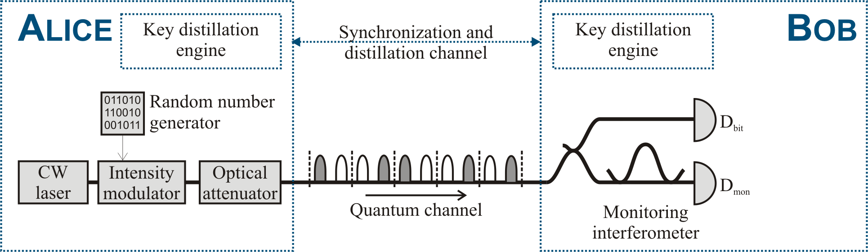
Coherent One-Way quantum key distribution 5
Preparation: Alice encodes information into two time-ordered coherent states
Measurement:
“Sifting”:
Post-processing:
Authentication:

Slide 6
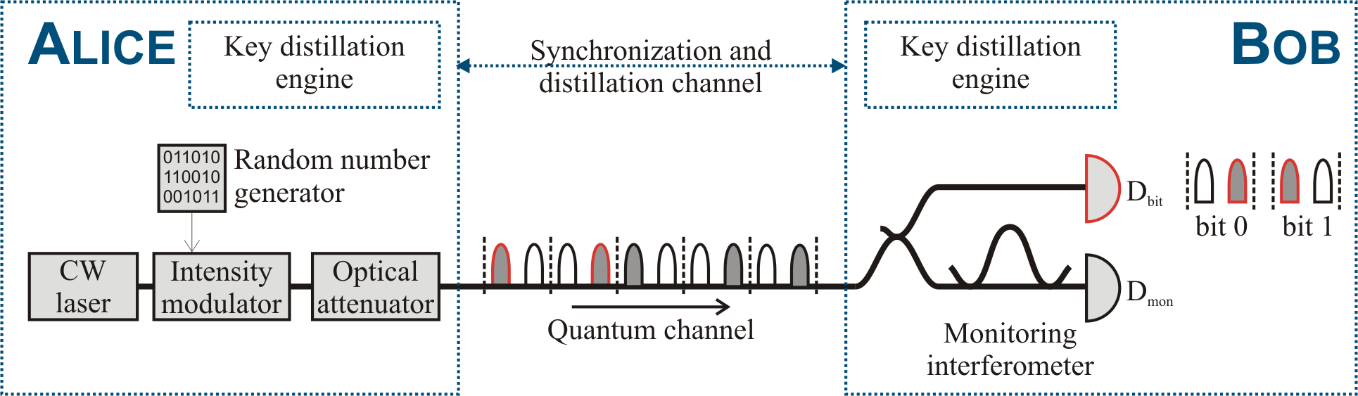
Coherent One-Way quantum key distribution 6
Preparation: Alice encodes information into two time-ordered coherent states
Measurement: Bob measures pulse arrival time (bit value) and coherence between bits (eavesdropper’s potential information about key).
“Sifting”: Bob tells Alice publicly, when and in which detector he measured (bit measurement or coherence measurement), incompatible measurements are discarded.
Post-processing:
Authentication:

Slide 7
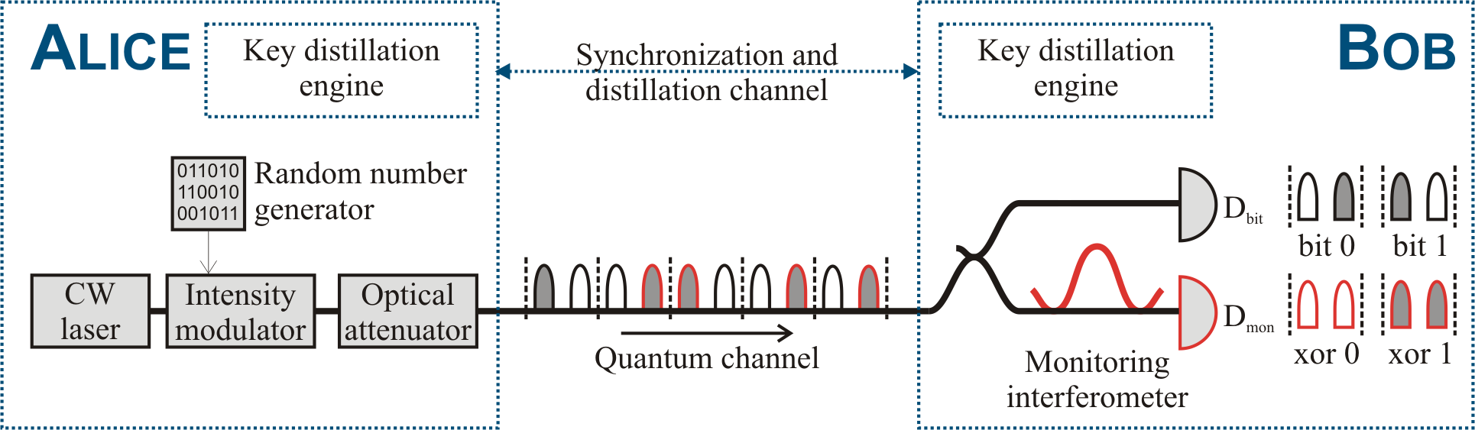
Coherent One-Way quantum key distribution 7
t_{B}
Preparation: Alice encodes information into two time-ordered coherent states
Measurement: Bob measures pulse arrival time (bit value) and coherence between bits (eavesdropper’s potential information about key).
“Sifting”: Bob tells Alice publicly, when and in which detector he measured (bit measurement or coherence measurement), incompatible measurements are discarded.
Post-processing:
Authentication:

Slide 8
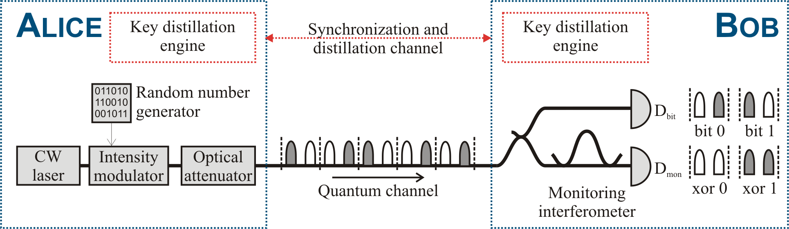
Coherent One-Way quantum key distribution 8
QBER
Visibility
Preparation: Alice encodes information into two time-ordered coherent states
Measurement: Bob measures pulse arrival time (bit value) and coherence between bits (eavesdropper’s potential information about key).
“Sifting”: Bob tells Alice publicly, when and in which detector he measured (bit measurement or coherence measurement), incompatible measurements are discarded.
Post-processing: Eliminate quantum bit errors and reduce eavesdropper’s potential information about the key.
Authentication:

Slide 9
Coherent One-Way quantum key distribution 9
Preparation: Alice encodes information into two time-ordered coherent states
Measurement: Bob measures pulse arrival time (bit value) and coherence between bits (eavesdropper’s potential information about key).
“Sifting”: Bob tells Alice publicly, when and in which detector he measured (bit measurement or coherence measurement), incompatible measurements are discarded.
Post-processing: Eliminate quantum bit errors and reduce eavesdropper’s potential information about the key.
Authentication: Assure that public communication is authentic. Secret key costs!

Slide 10
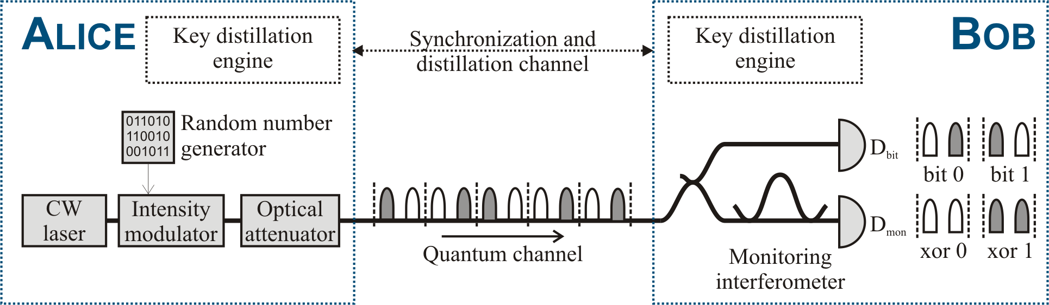

Coherent One-Way quantum key distribution 10
Advantages of modification
No decoy states
One-way sifting
One basis - no sifting losses
More robust against USD attacks
No active elements at Bob
Robust bit measurement basis
Robust against PNS
Security proof for zero error attacks and some collective attacks
C. Ci Wen Lim, N. Walenta, H. Zbinden. A quantum key distribution protocol that is highly robust against unambiguous state discrimination attacks. Submission in process..
H. Zbinden, N. Walenta, C. Ci Wen Lim. US-Patent Nr. 13/182311.

Slide 11
Security against zero-error attacks 11
Secret key fraction
Distance [km]
Poster session 16:00 - 18:00
C. Ci Wen Lim, N. Walenta, H. Zbinden. A new Coherent One-Way protocol that is highly immune against unambiguous state discrimination attacks. M. Mafu, A. Marais, F. Petruccione. Towards the security of coherent-one-way quantum key distribution protocol.

Slide 12
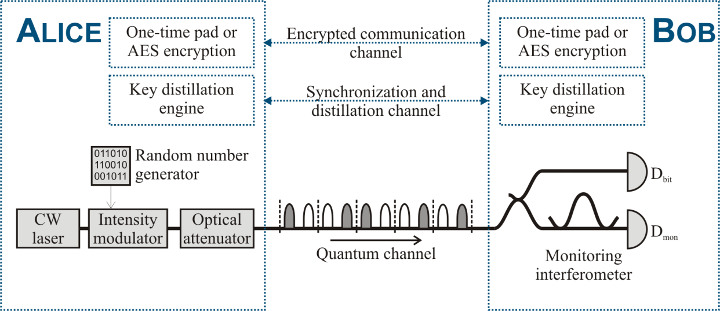
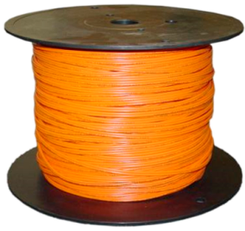
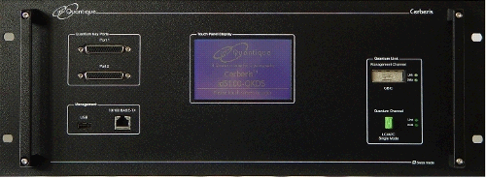
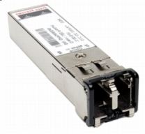
Dense wavelength division multiplexing 12
DWDM
DWDM
Multiplexing classical channels (> -28 dBm) along with quantum channel (< -71 dBm) on 100 GHz DWDM grid
Channel crosstalk
„Off-band noise“ due to finite channel isolation of the multiplexers
Reduced below detector dark counts by MUX channel isolation (-82 dB)
Raman scatter
Scattering off optical phonons, in forward and backward direction
Dominating for fibre lengths > 10 km

Slide 13
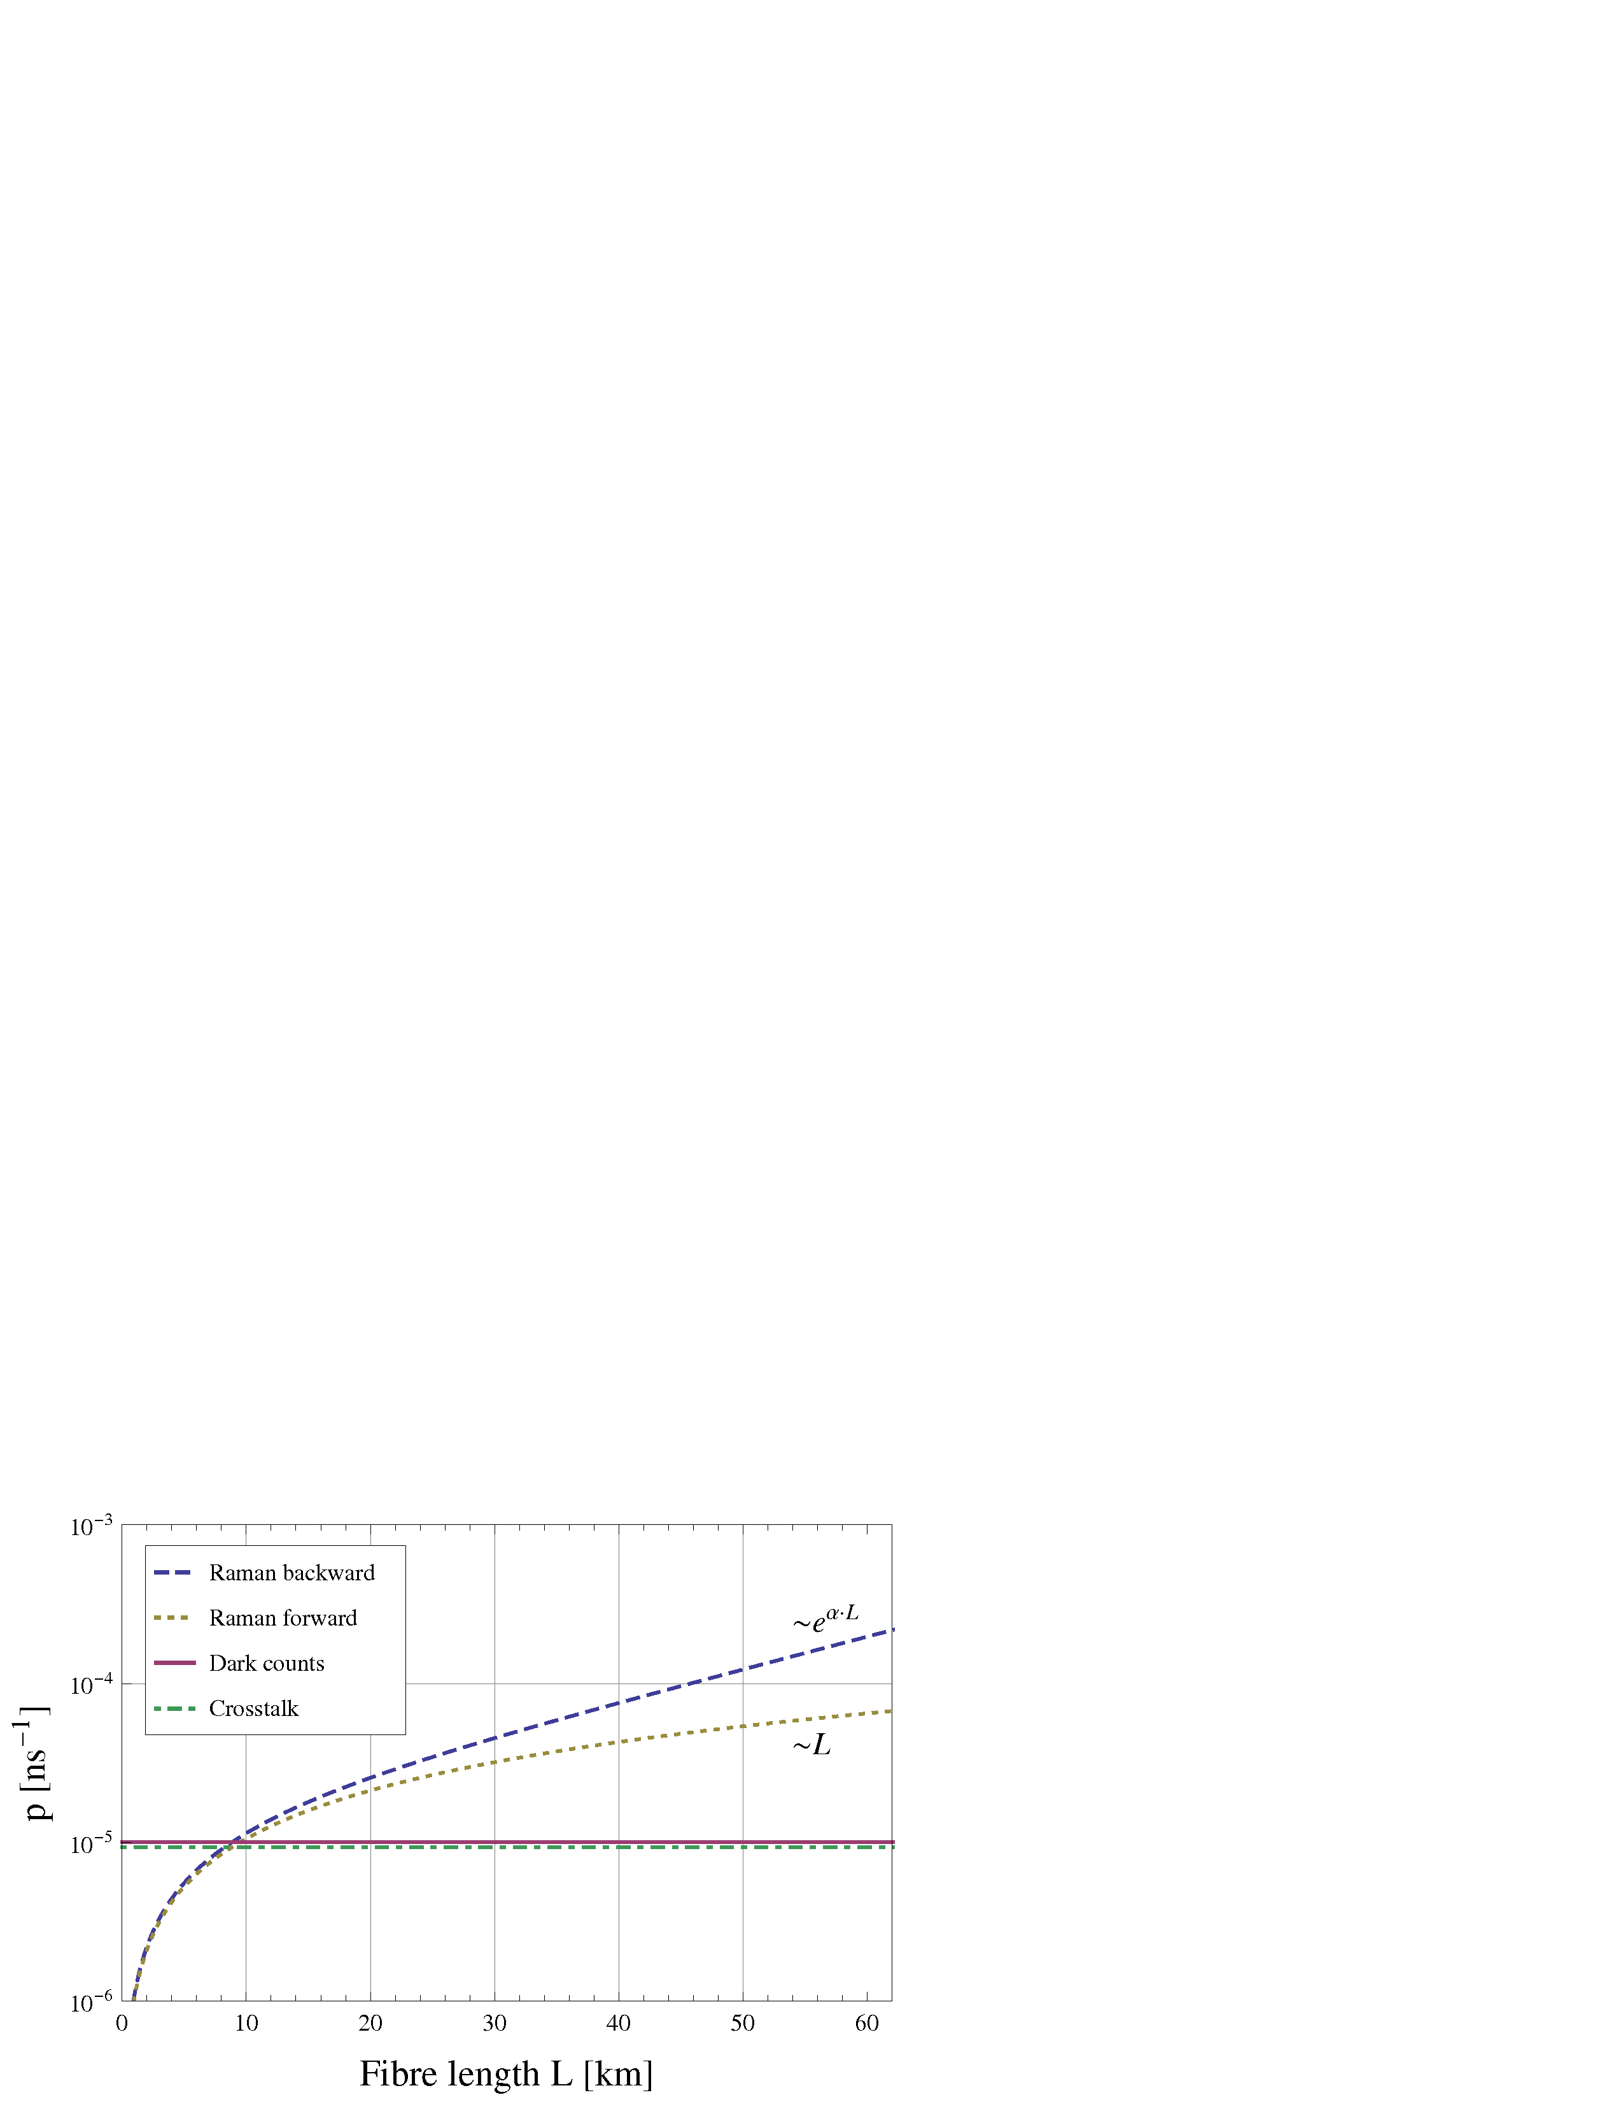
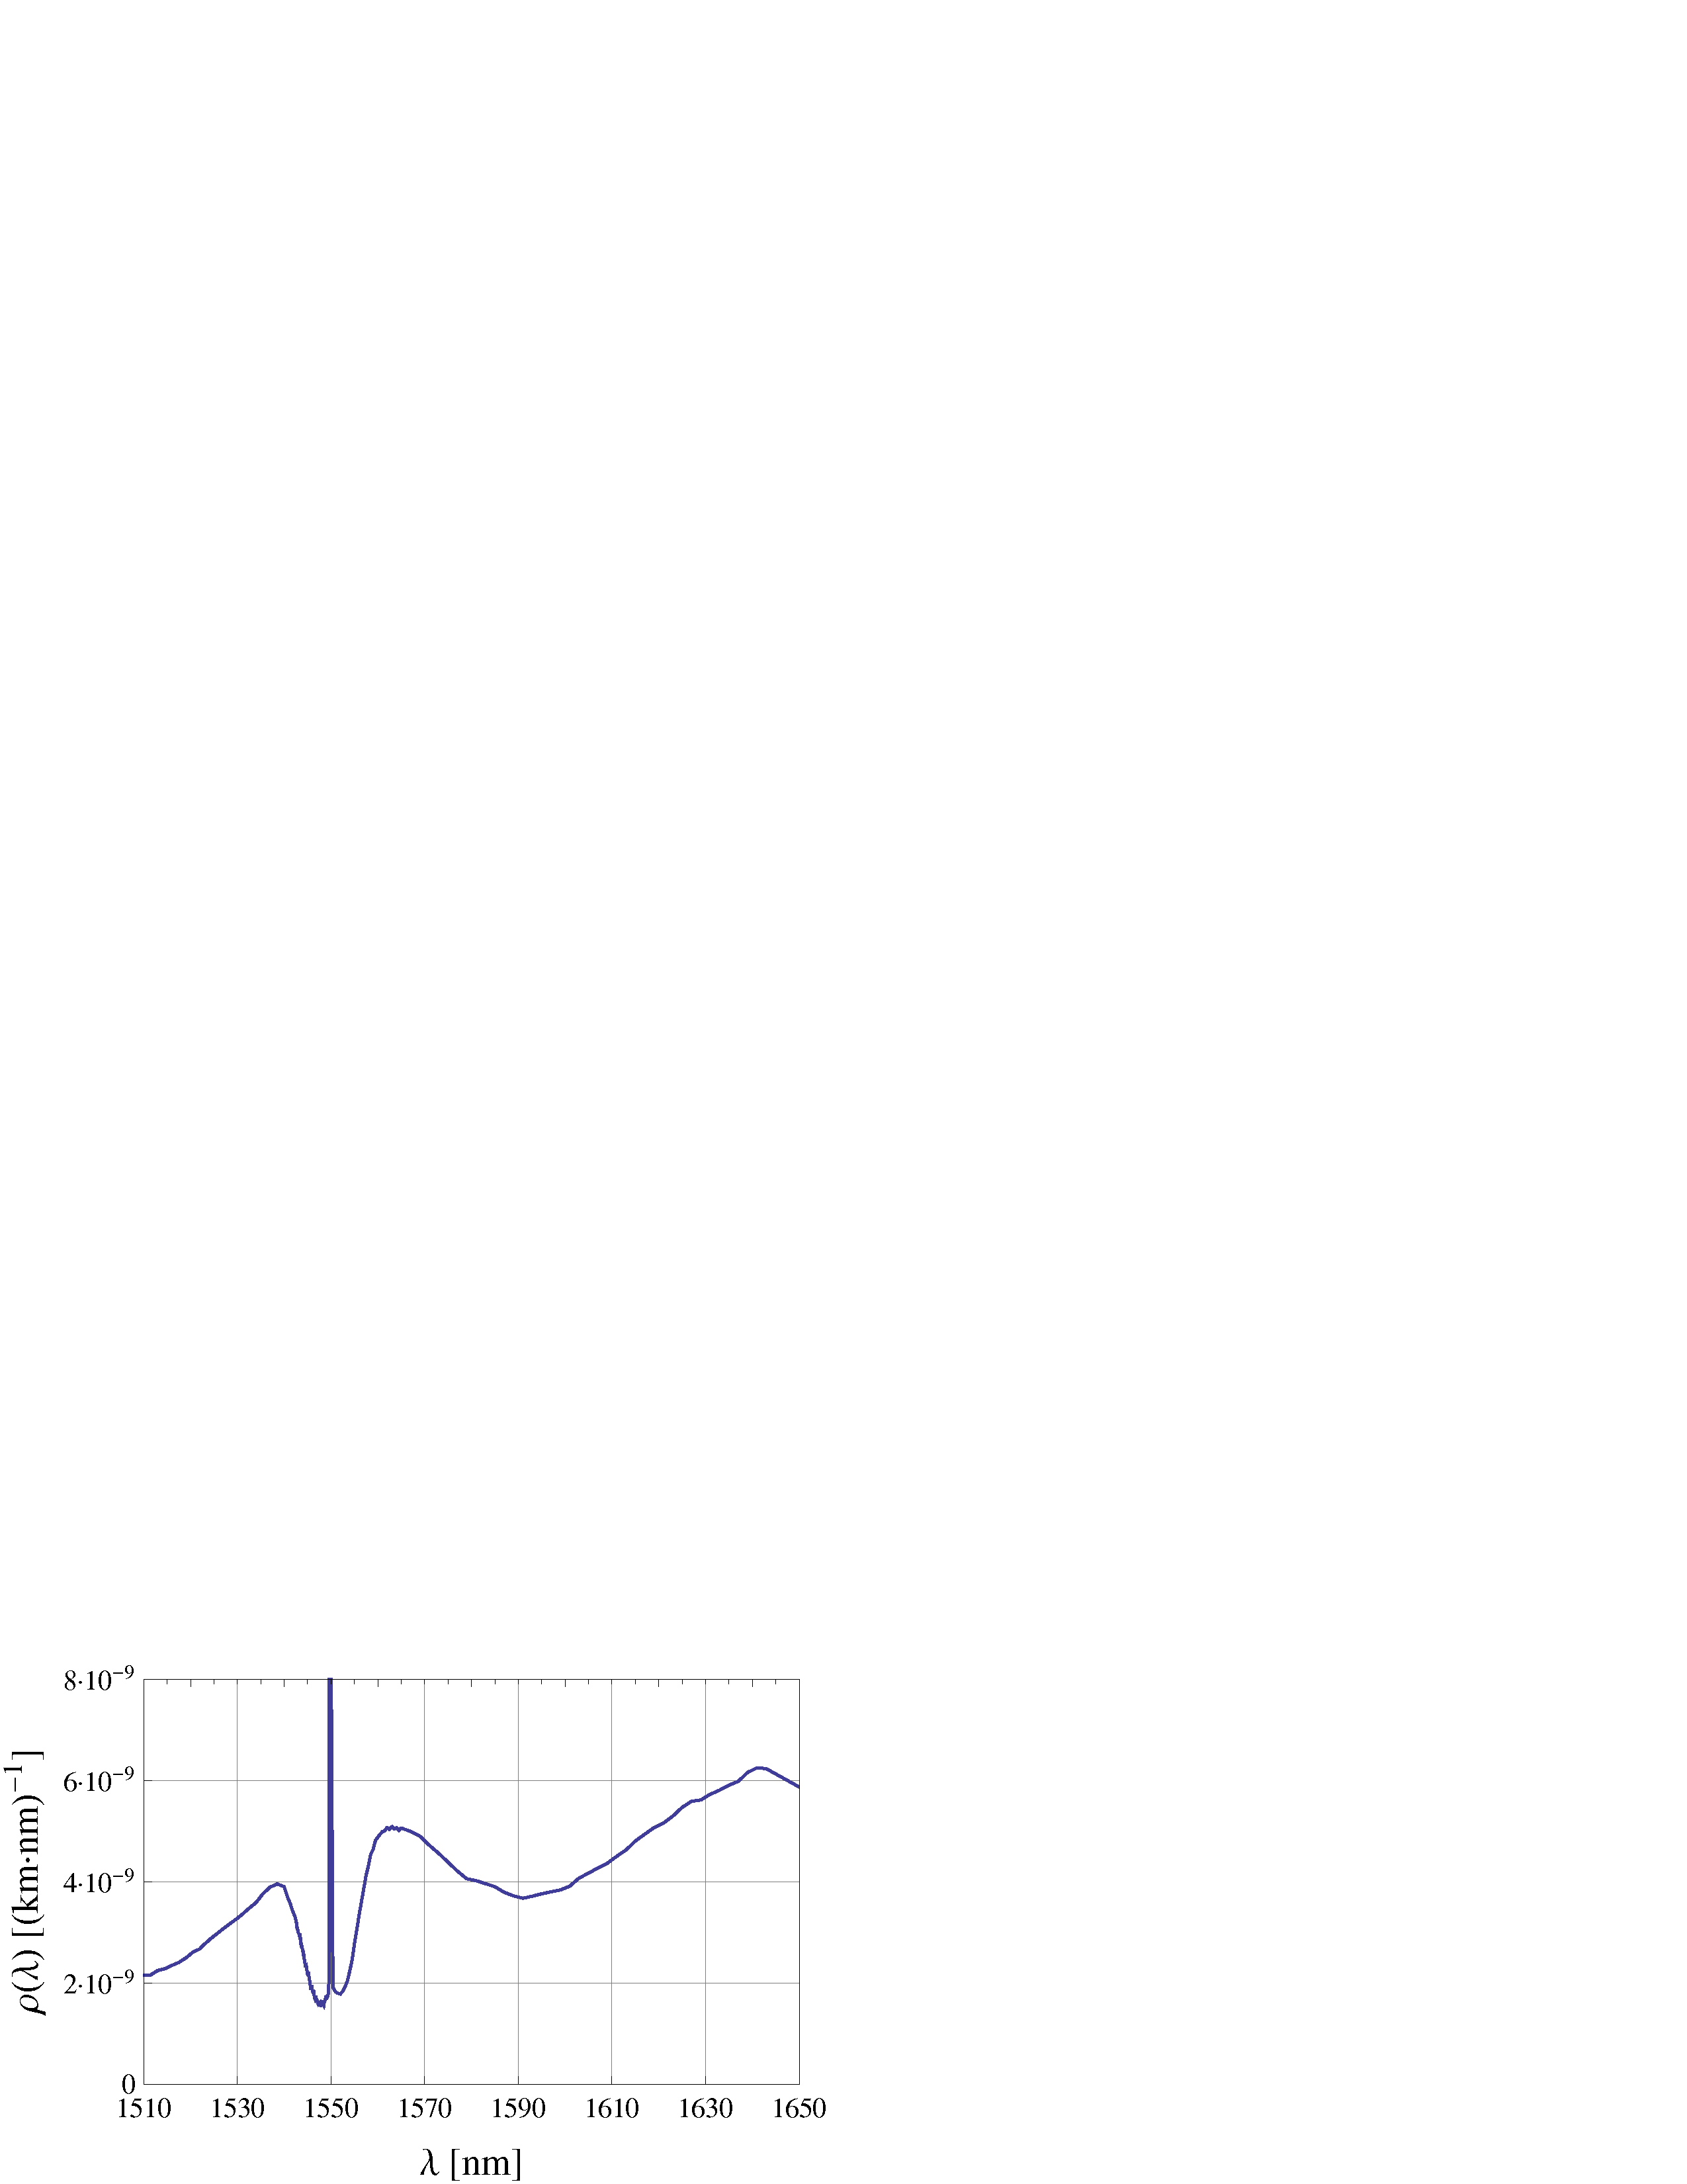
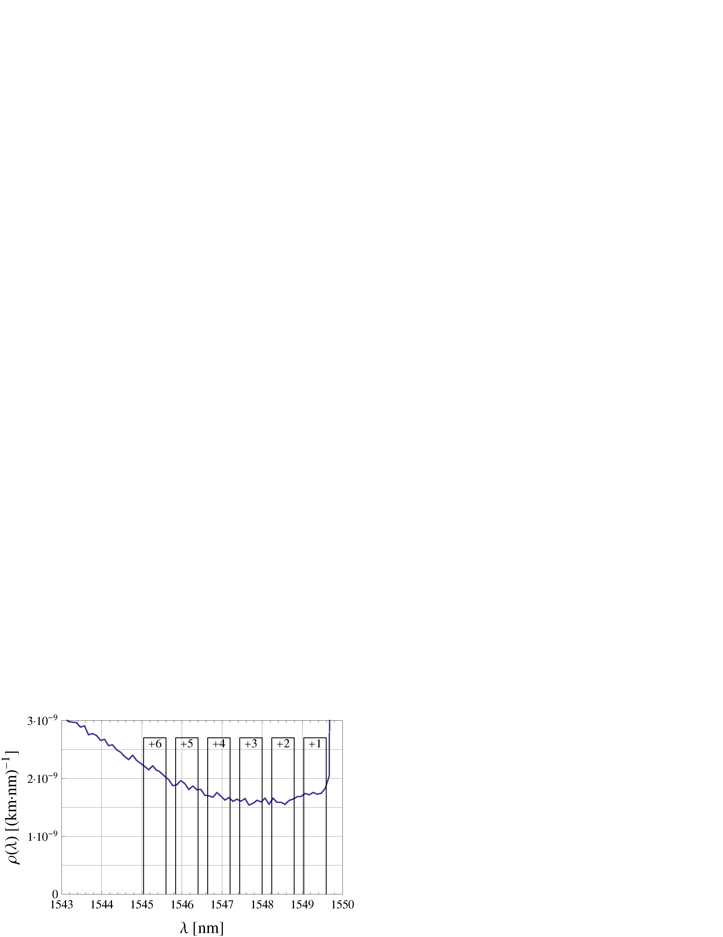
DWDM impairment sources 13
Channel crosstalk
„Off-band noise“ due to finite channel isolation of the multiplexers
Reduced below detector dark counts by MUX channel isolation (-82 dB)
Raman scatter
Scattering off optical phonons, in forward and backward direction
Dominating for fibre lengths > 10 km
P. Eraerds, N. Walenta et al. Quantum key distribution and 1 Gbps data encryption over a single fibre. NJP 12, 063027 (2010).

Slide 14
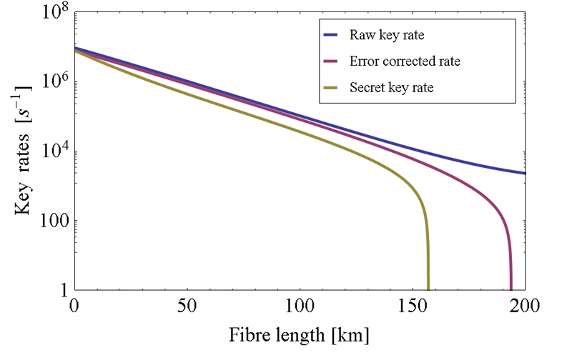
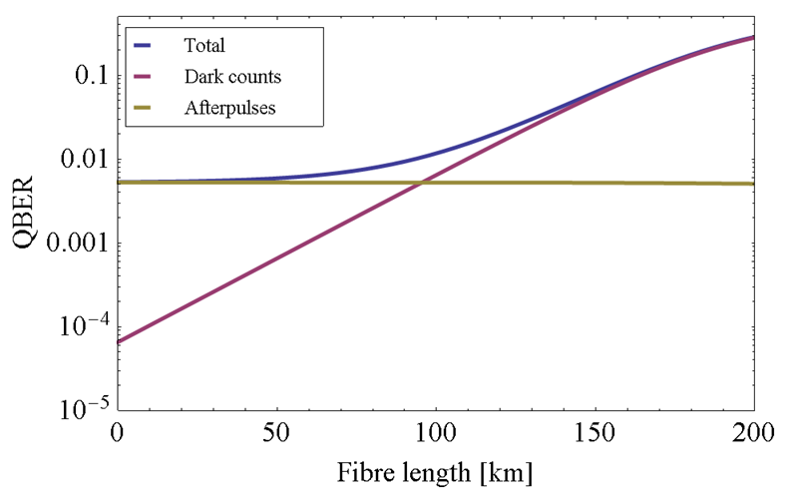
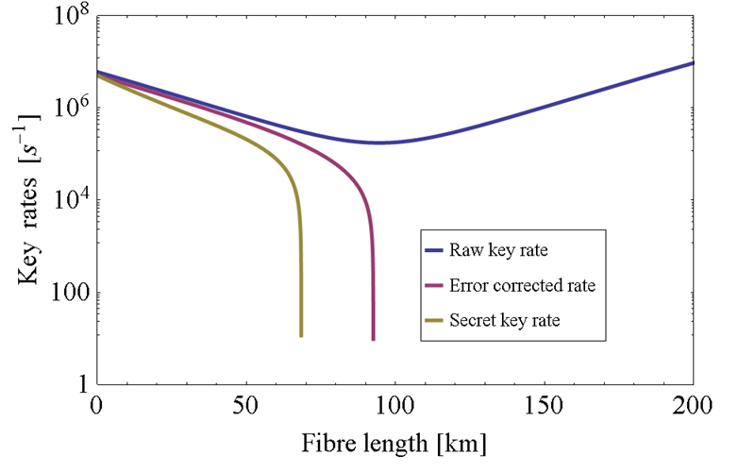
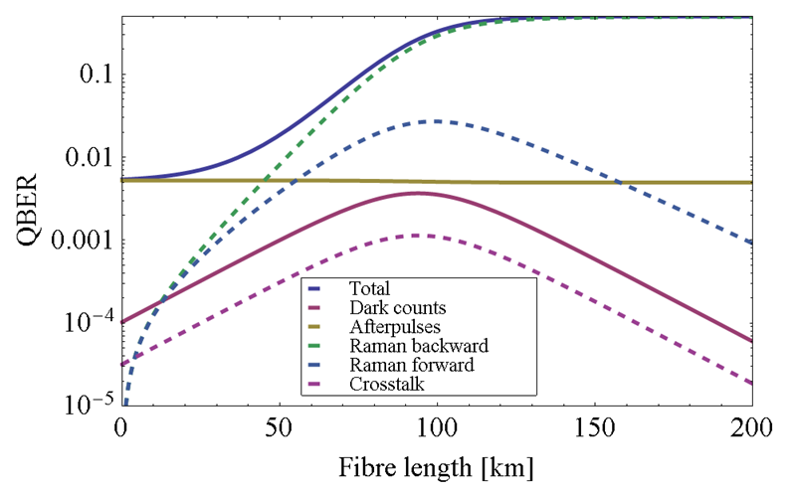
QKD performance estimates 14
2-fibre configuration
1-fibre DWDM configuration

Slide 15
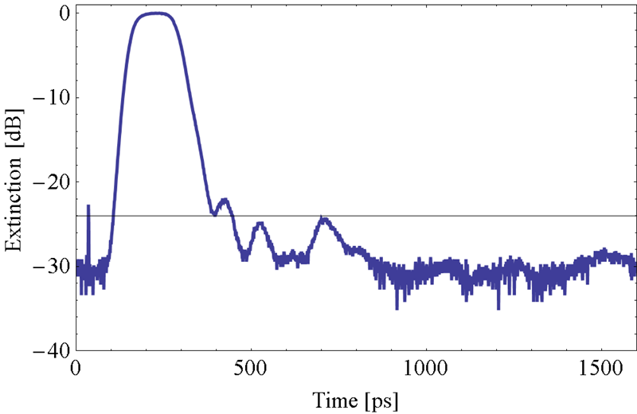
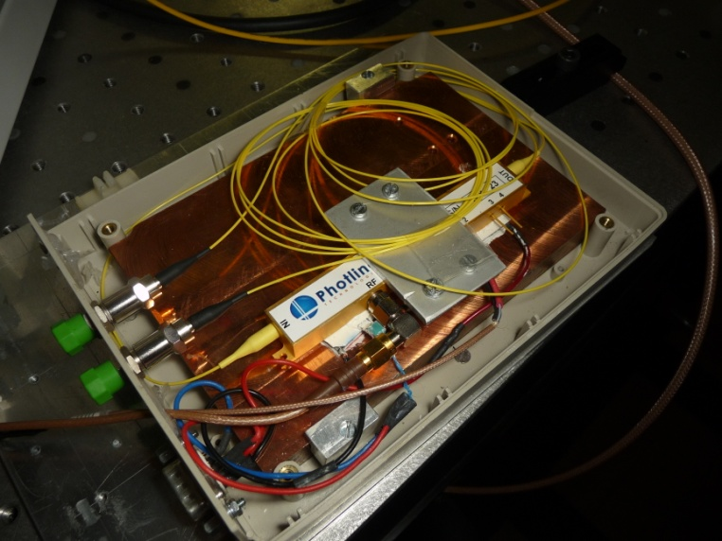
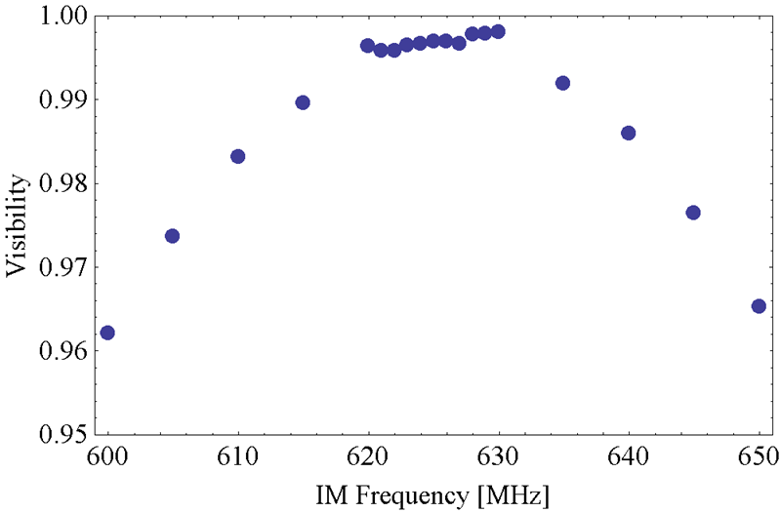
Fast pulse pattern modulation 15
Δt_{fwhm}130 ps
250 ps
Pulse amplitude modulation
Off-the-shelf components
High extinction ratio → QBER_{IM} < 0.2 %
High visibiliy
625 MHz Pulse pattern repetition frequency
V > 0.995

Slide 16
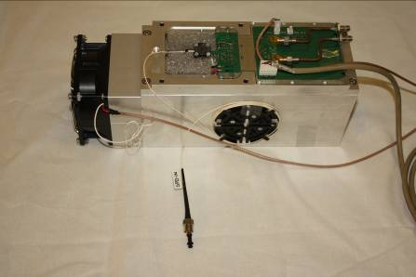
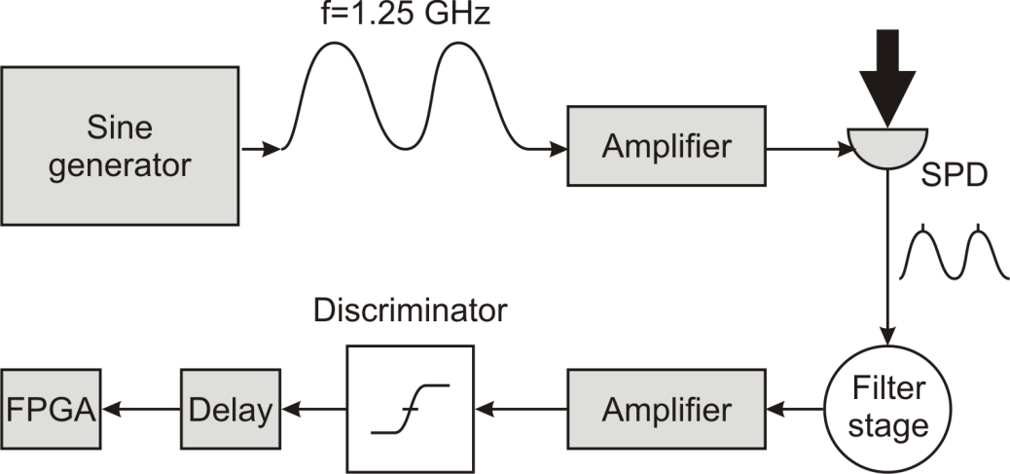
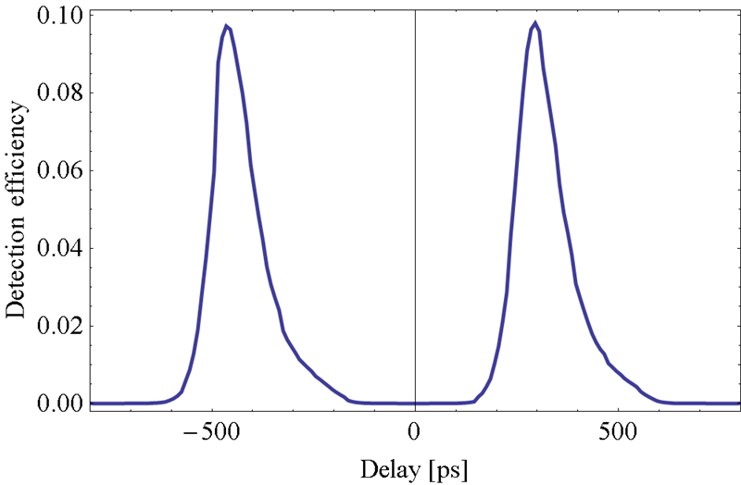
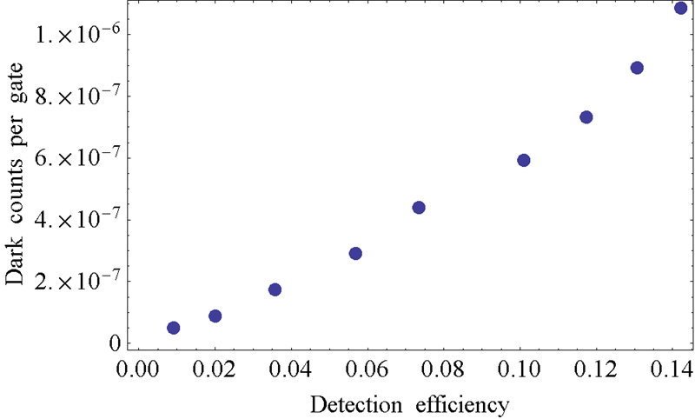
Rapid gated single photon detectors 16
130 ps

Slide 17
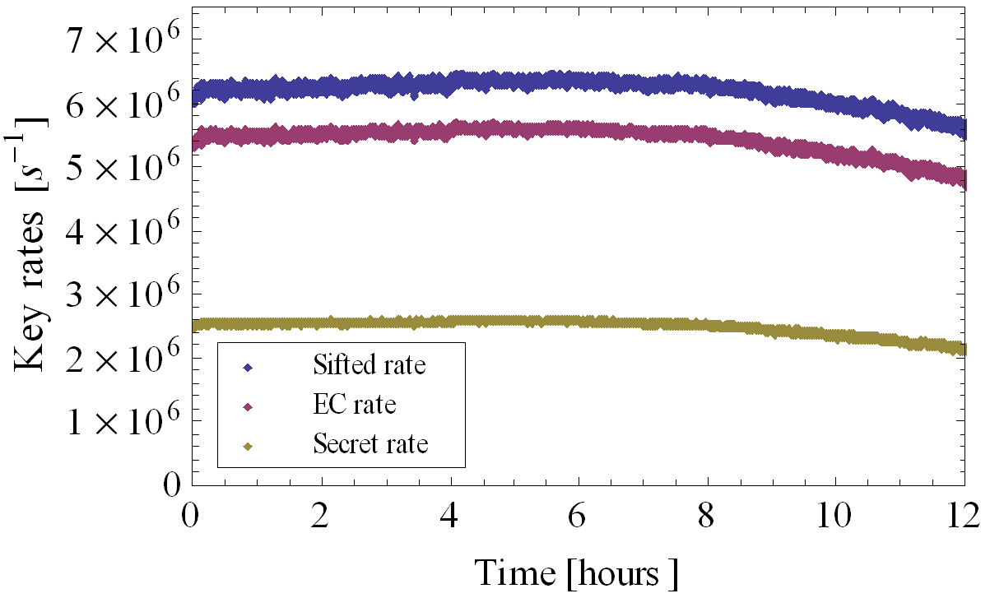
QKD performance estimates 17
0 km
50 km
100 km
Rapid gated single photon detectors
Low dead time 8 ns
Low afterpulse probability < 1%
High detection rates > 33 MHz
Peltier cooled InGaAs diode
Compact design

Slide 18
Hardware key distillation engine 18
Sifting
Timing and base information
Bit permutation
Ommited
Error estimation
Random sampling for QBER
Error correction
LDPC forward error correction
Privacy amplification
Toeplitz hashing
Error verification
CRC check
Authentication
Polynomial hashing
Key size
Hardware limits on maximal key length
Memory
Throughput

Slide 19
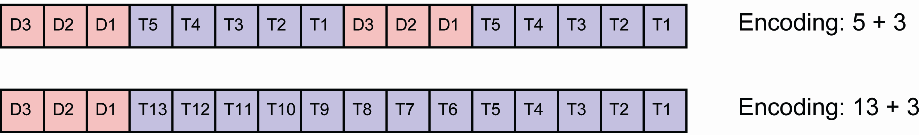
Sifting channel 19
High detection rate
D3 | D2 | D1
0 | 0 | 1 | Data detection
0 | 1 | 0 | IF detection at t₁
0 | 1 | 1 | IF detection at t₂
1 | 0 | 0 | Bit 0 for QBER estimation
1 | 0 | 1 | Bit 1 for QBER estimation
1 | 1 | 1 | Include next block
Low detection rate
Indicator bits
Timing bits, relative to last detection

Slide 20
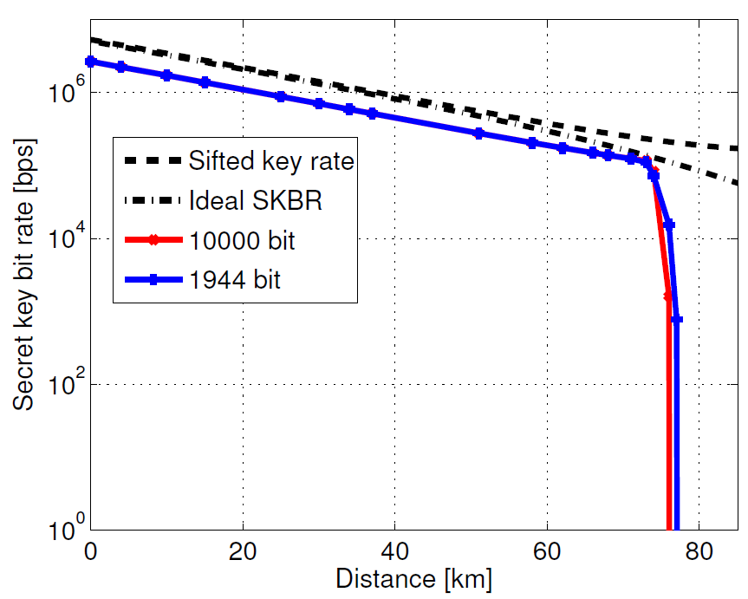
LDPC Information reconciliation 20
Low-density parity-check codes
Ensure integrity of secret keys with minimum redundancy through forward error correction and privacy amplification
Theoretically capacity-approaching - practically ressource limited efficiency
Reverse reconciliation
FPGA implementation
Syndrome of length
C. Roth, P. Meinerzhagen, C. Studer, A. Burg. "A 15.8 pJ/bit/iter quasi-cyclic LDPC decoder for IEEE 802.11n in 90 nm CMOS," Solid State Circuits Conference (A-SSCC), 2010 IEEE Asian, (2010)

Slide 21
Privacy amplification 21
Toeplitz hashing
Alice and Bob have to agree on a randomly selected Toeplitz matrix
k + n_{sift} -1 bits of communication
Seed of length
H. Krawczyk. LFSR-based hashing and authentication. Lecture Notes in Computer Science 839 (1994)
C.Branciard et al. Upper bounds for the security of two distributed-phase reference protocols of quantum cryptography. NJP 10, 013031 (2008).

Slide 22
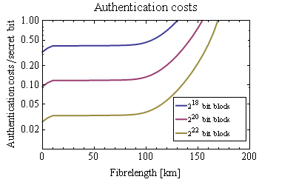
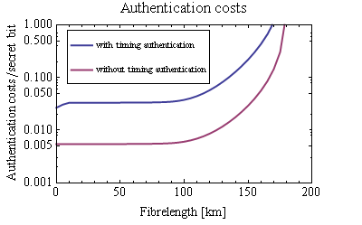
Information theoretic authentication 22
tag
length
Security
parameter
Secret bits
D.R. Stinson. Universal hashing and authentication codes. Advances in Cryptology ‘91.
D.R. Stinson. Universal hashing and authentication codes. Designs, Codes and Cryptography, 4 (1994).

Slide 23
Information theoretic authentication 23
tag
length
Security
parameter
Secret bits
Polynomial hashing
Construct an almost universal family of hash functions and apply a strongly universal hash function at the end.
D.R. Stinson. Universal hashing and authentication codes. Designs, Codes and Cryptography, 4 (1994).

Slide 24
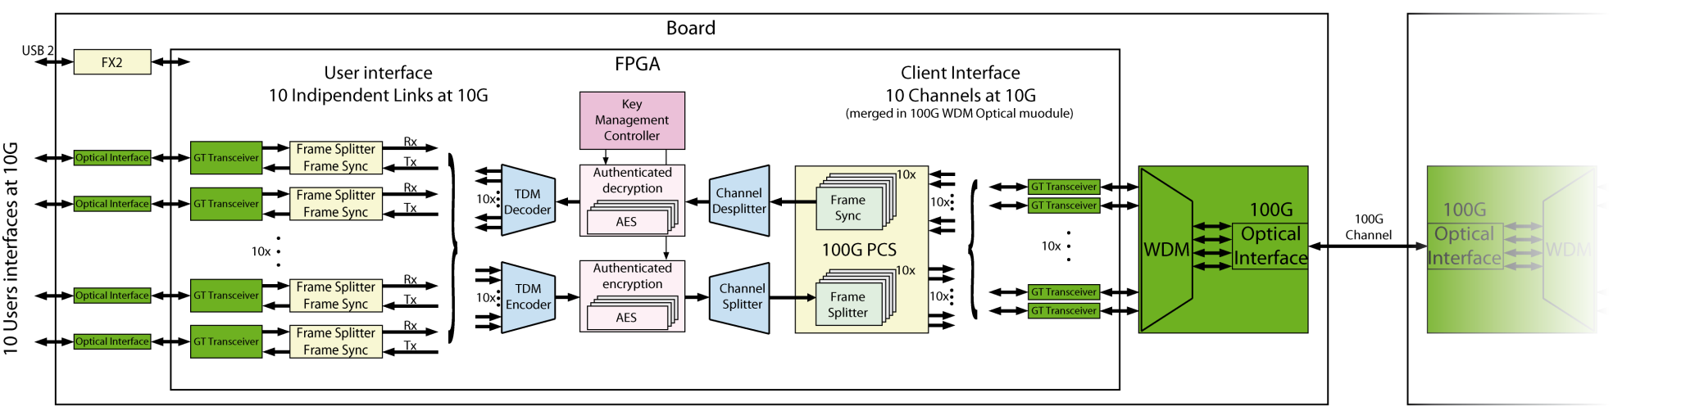
100 Gbit/s Encryption engine 24
10 x 10 Gbit/s Users interfaces
1 x 100 Gbit/s Client interface
FPGA design and 100 Gbps Interface
User side: 10 x 10 Gbit/s Ethernet channels through 10 SPF+ optical modules
Client side: 1 x 100 Gbit/s channel over a single fibre using WDM optical module feeds with 10 x 10 Gbit/s high-speed serial links
All synchronization and channels splitting made in the FPGA

Slide 25
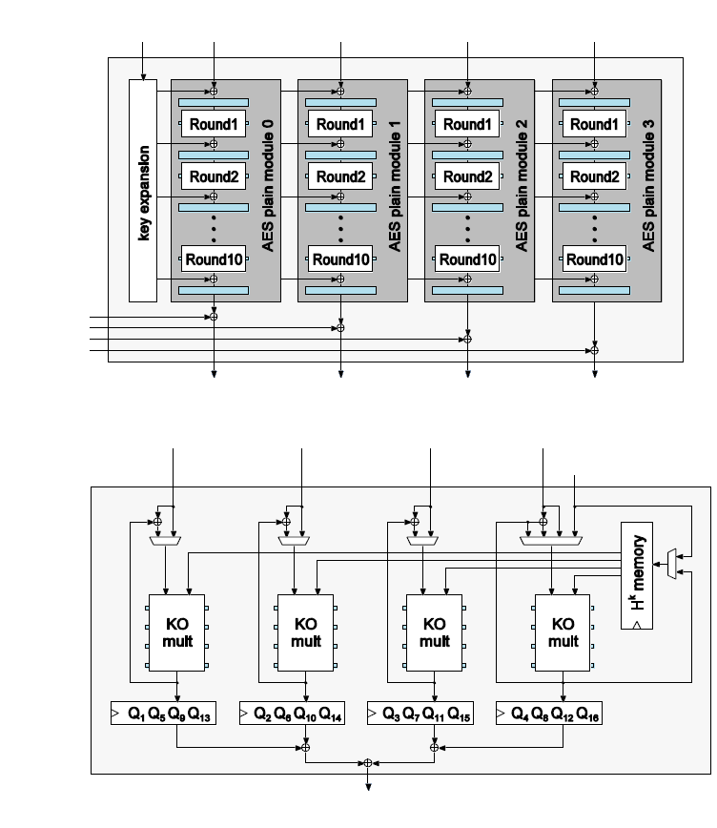
100 Gbit/s AES-GCM encryption 25
Key
Basic AES: 1 – 2 Gbit/s
20 x pipelining: requires feedback-free Encryption mode
4 x parallelization: data-independent partitioning → Counter mode
Plaintext
Cyphertext
Basic Authentication: 4 – 8 Gbit/s
4 x pipelining
4 x parallelization → 4 Galois field multipliers (x¹²⁸+x⁷+x²+x+1)
Two engines for En- and Decryption
Authenticated data and cyphertext
Authentication tag

Slide 26
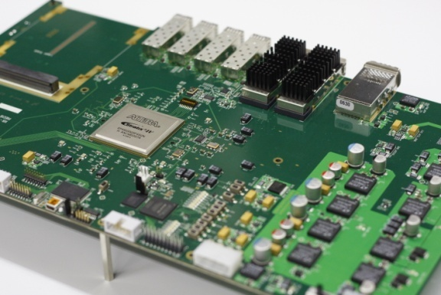
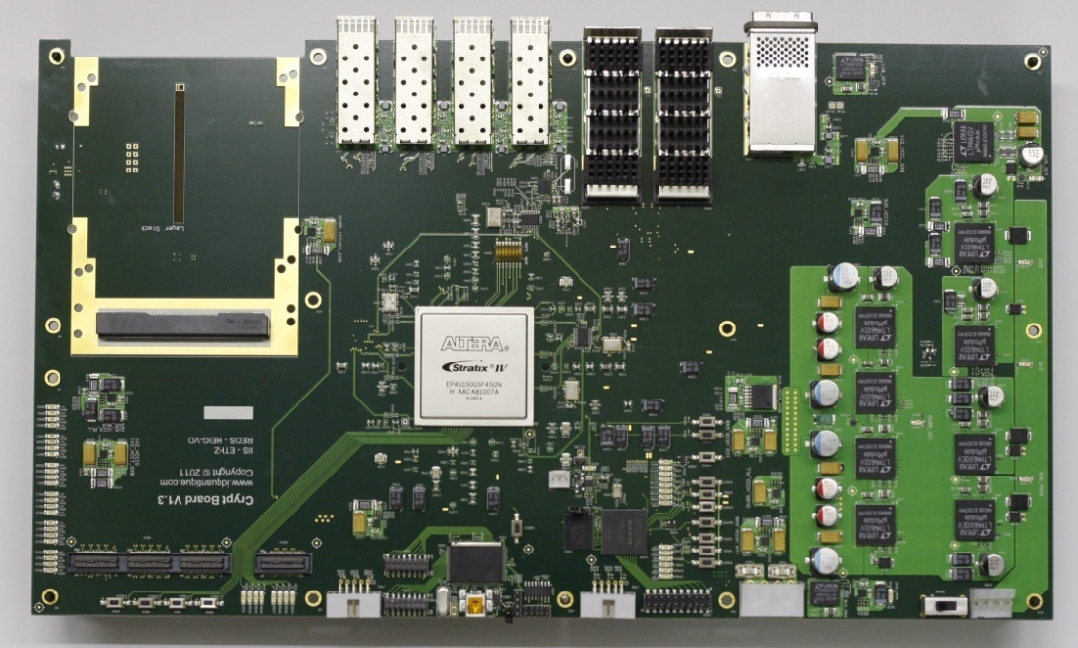
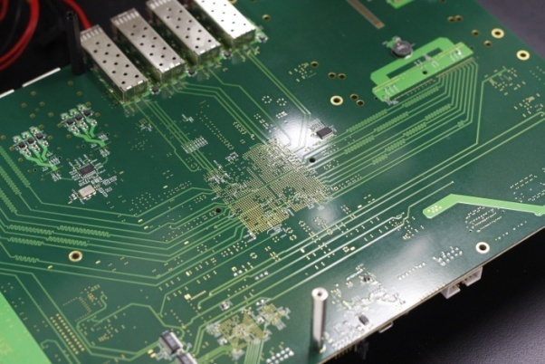
100 Gbit/s Fast encryption board 26
100 Gbit/s Fast Encryption Board
PCB: 24 layers, 52 high-speed serial links,10 power supplies
Communication links: 22x High-speed serial 6.5 Gbit/s 8x SFP+; 2x XFP 10 Gbit/s 1x CXP; 1x CFP 100 Gbit/s
FPGA main power supply: 0.95 V, 40 A

Slide 27
Outlook 27
Real network compatibility and integration
Side channel analysis
Tamper detection
Resistance against detector blinding attack
Certification
Afterpulsing reconcillation

Slide 28
Questions, please! 28
Real network compatibility and integration
Side channel analysis
Tamper detection
Resistance against detector blinding attack
Certification
Afterpulsing reconcillation
Thank you for your attention!

